Slide 1


RECLASS/
A
USERSCRIPT
for tagging names and batch-transfer
Notes:
https://publicdomainvectors.org/en/free-clipart/Vector-clip-art-of-multi-colored-PC-folder-icon/31041.html

Slide 2
PLEASE
USE only with Google Chrome
ENSURE that you test extensively with non-important names first
You can tag names and transfer only the tagged names first
Be sure that you copy the complete address from Bob without errors
Never share your SECRET with anyone
Please reload the whole userscript between each batch
Allow 2 to 14 days for the transfer to complete

Slide 3
RECLASS/
INSTALLING
this userscript
Notes:
https://publicdomainvectors.org/en/free-clipart/Vector-clip-art-of-multi-colored-PC-folder-icon/31041.html

Slide 4
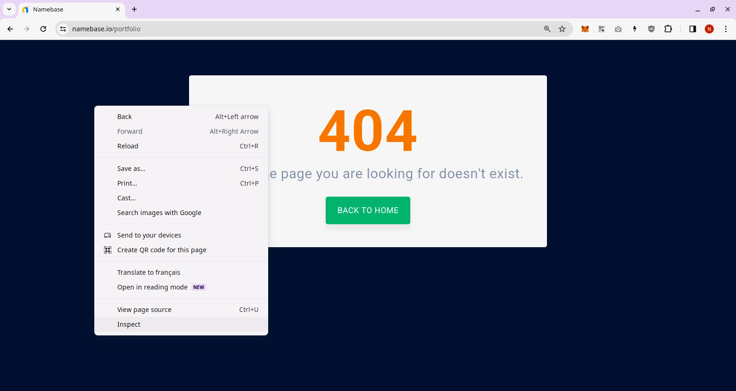
1
2
RIGHT-CLICK
3

Slide 5
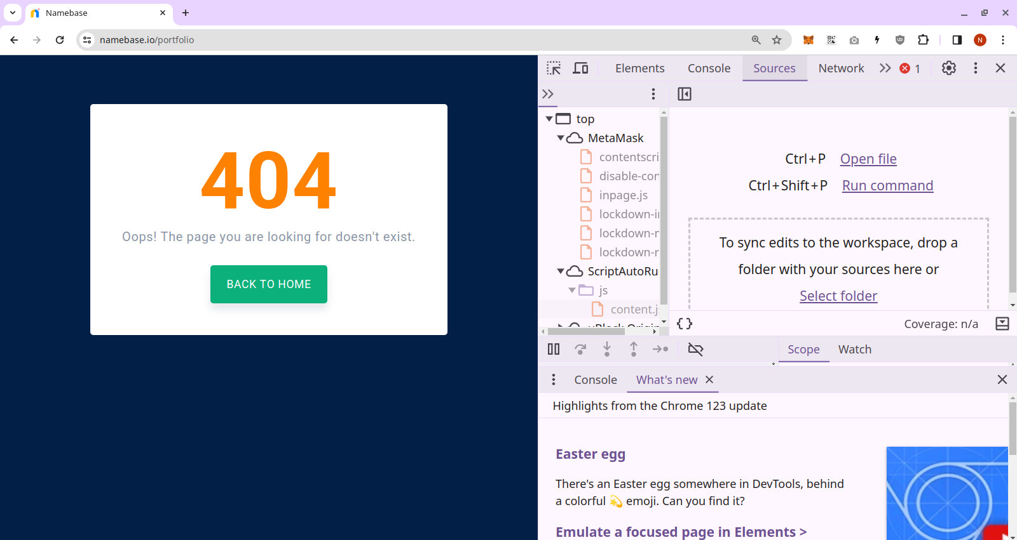

Slide 7
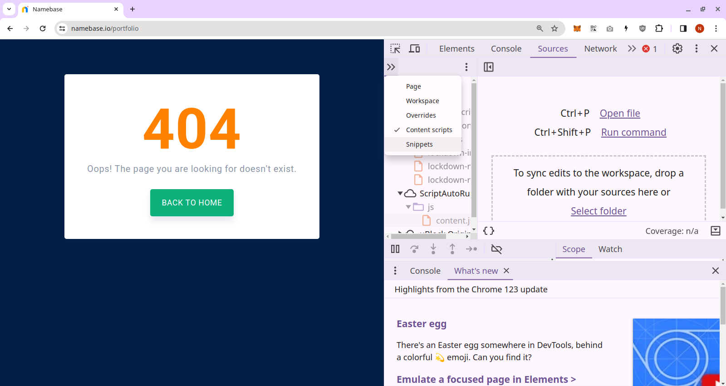

Slide 8


Slide 9


Slide 10

You copy the code from Github

Slide 11
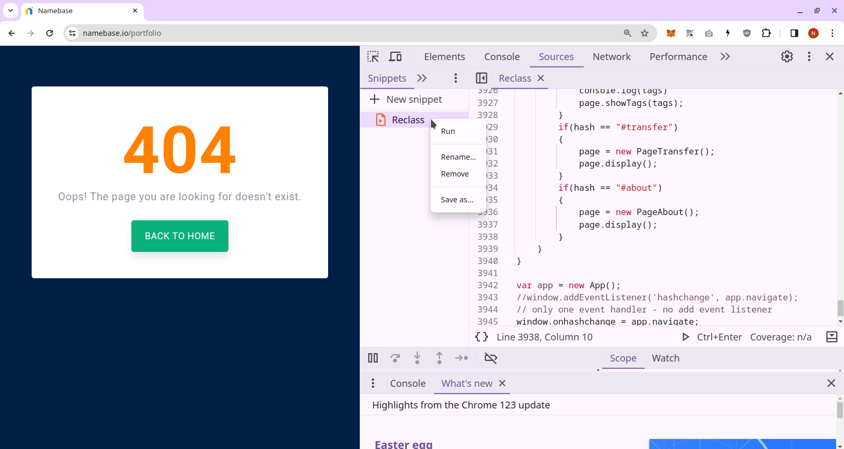
RIGHT-CLICK

Slide 12
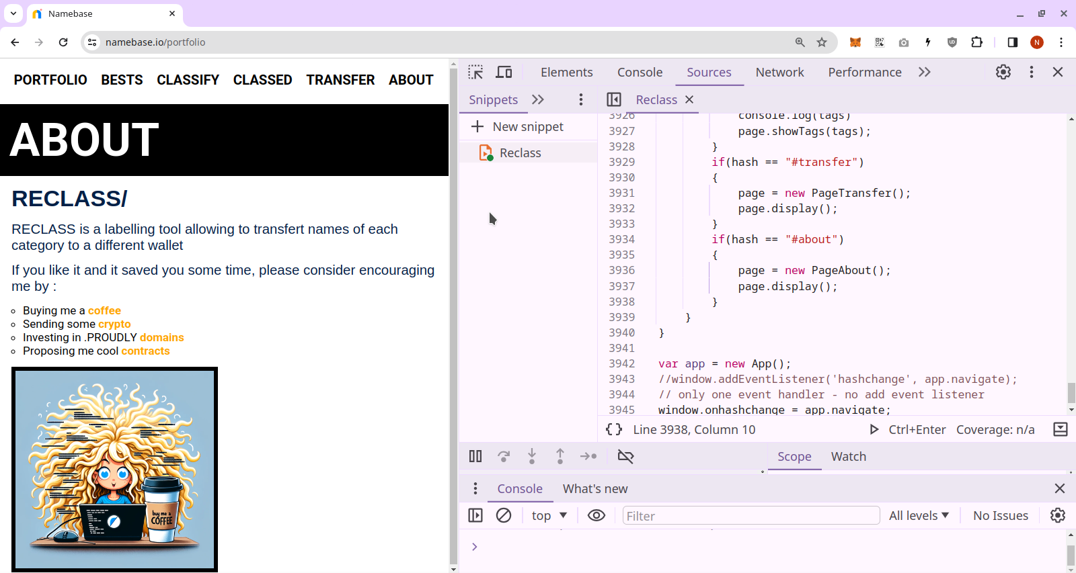
THE user script then load into the web page.

Slide 13
RECLASS/
USING
this userscript
Notes:
https://publicdomainvectors.org/en/free-clipart/Vector-clip-art-of-multi-colored-PC-folder-icon/31041.html

Slide 14
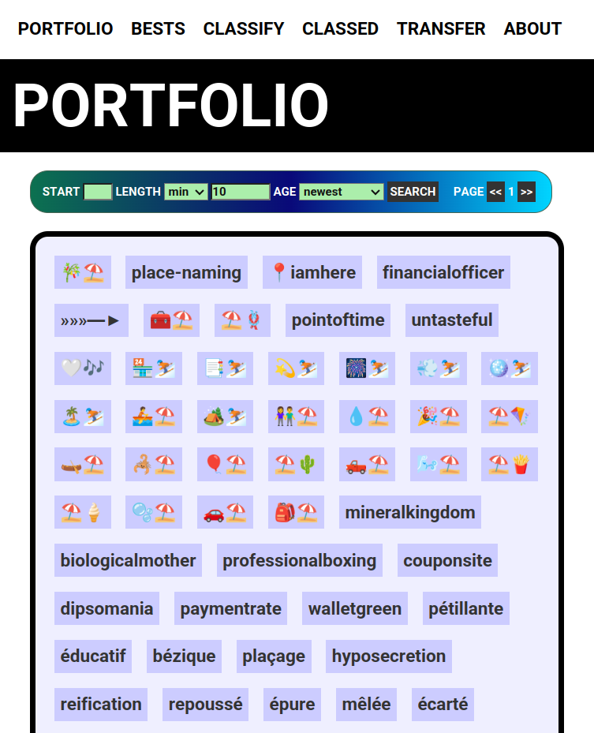
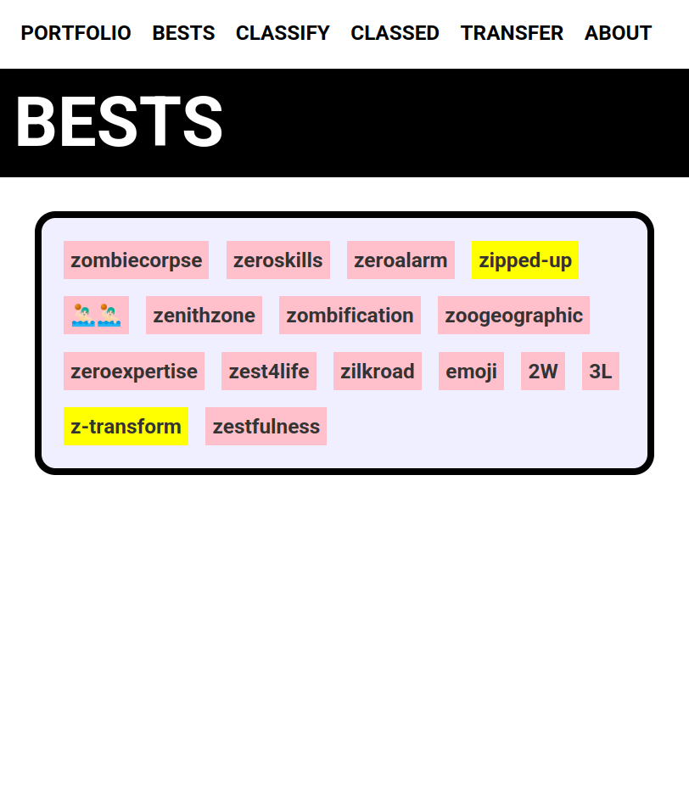
This is of no use for the transfer
But you can star the portfolio names, they then appear in bests.

Slide 15
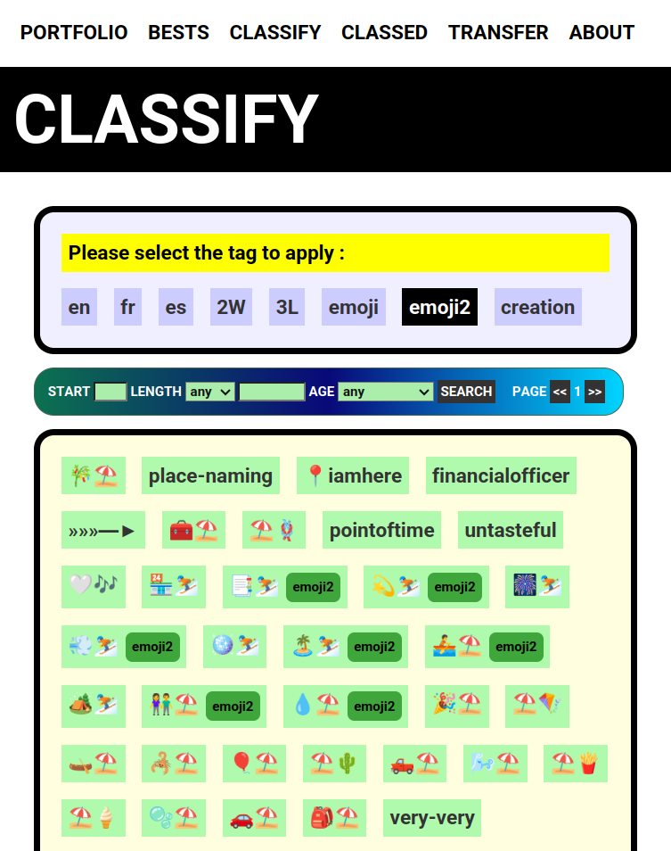
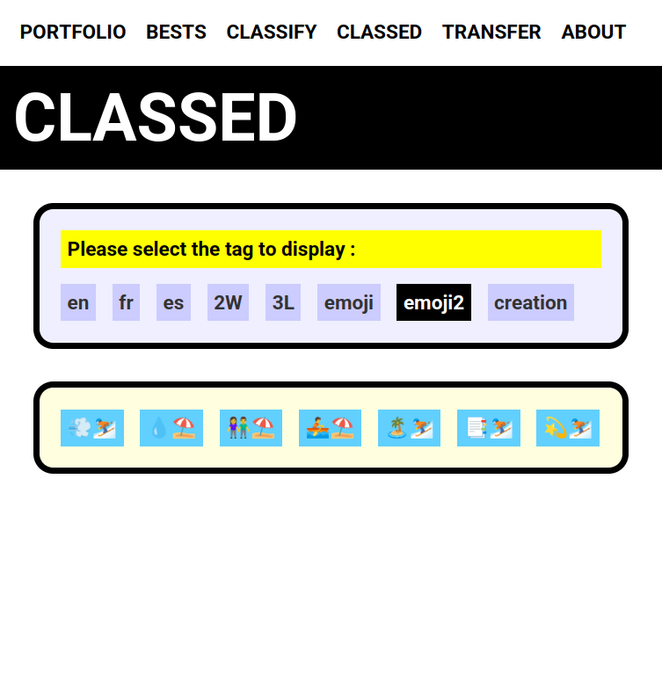
The name you tagged appear in the CLASSED screen
This is useful for the transfer

Slide 16
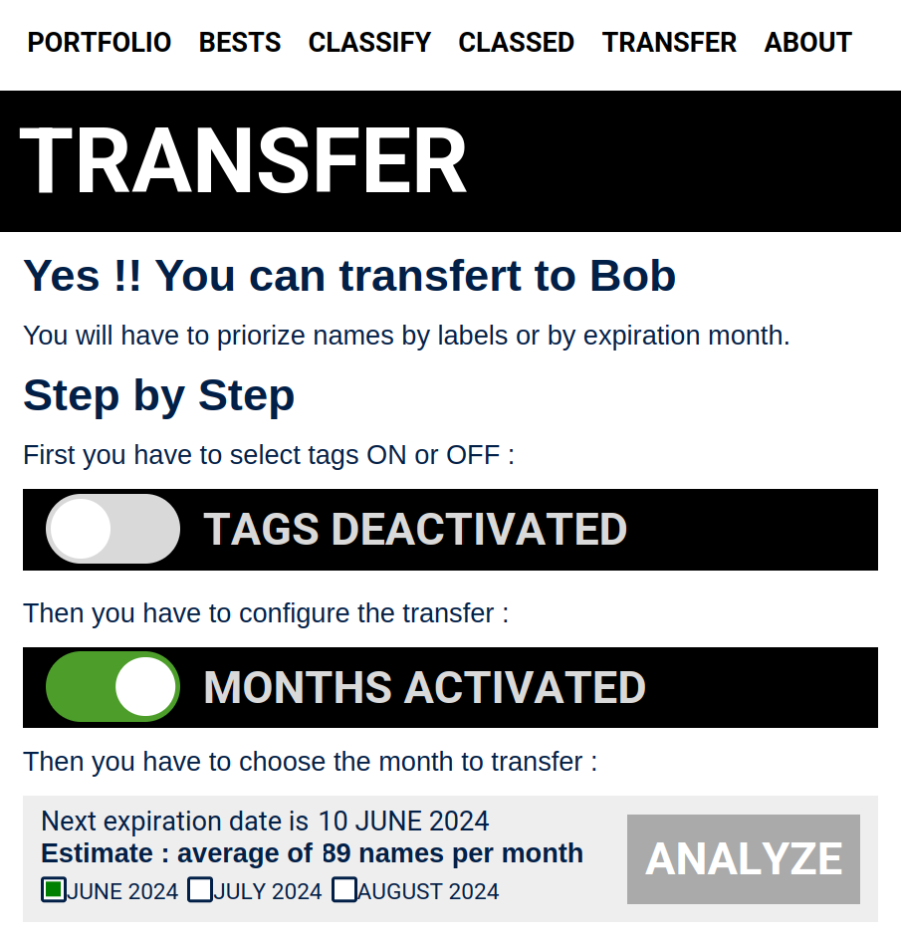
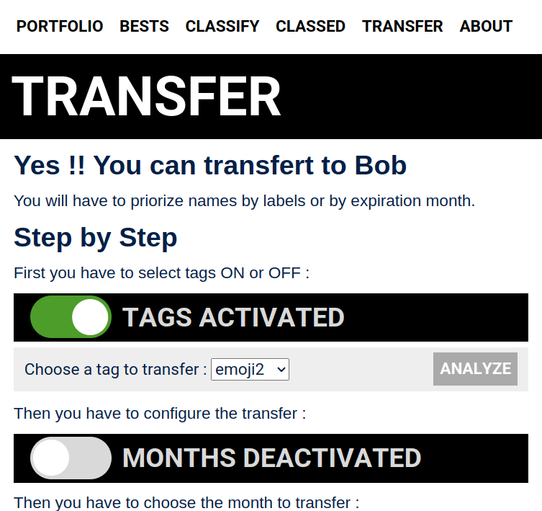
I select the tag I want to transfer
1
2
3
If for example I activate the tags
When you analyze, the list of names is generated

Slide 17
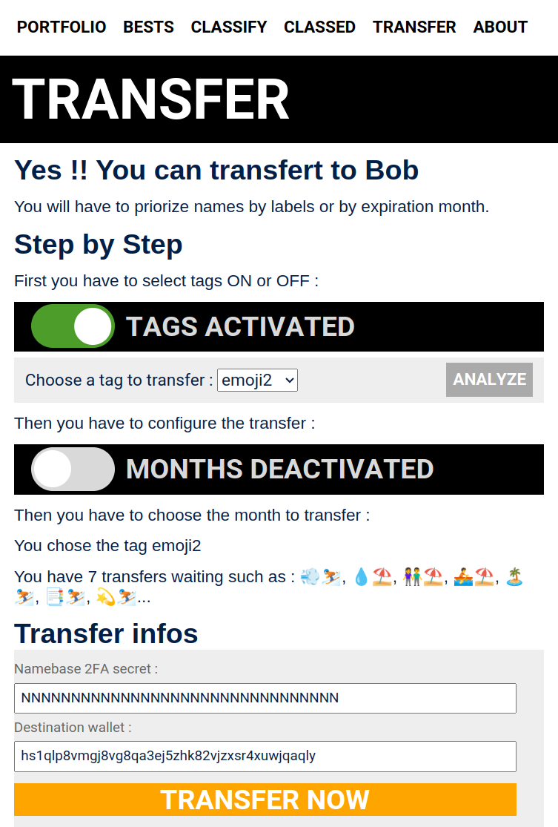
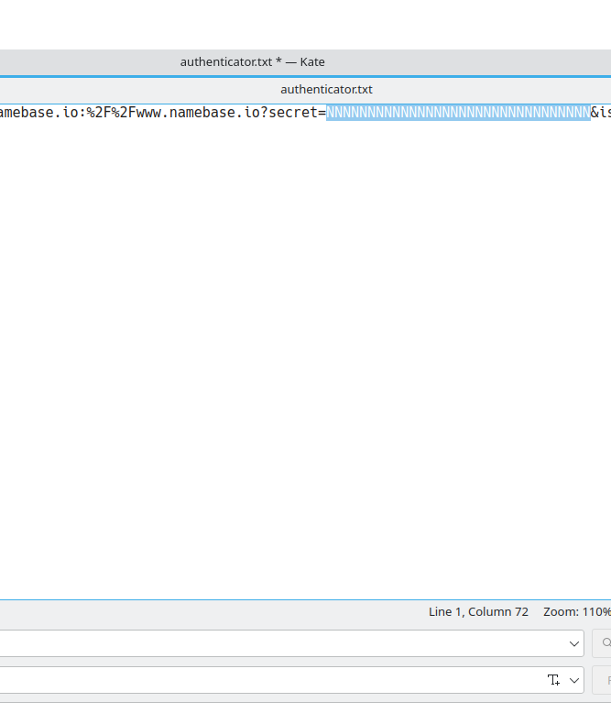
From the authenticator you export the secret
You can check that the names are right
This value goes into the Namebase 2FA secret

Slide 18
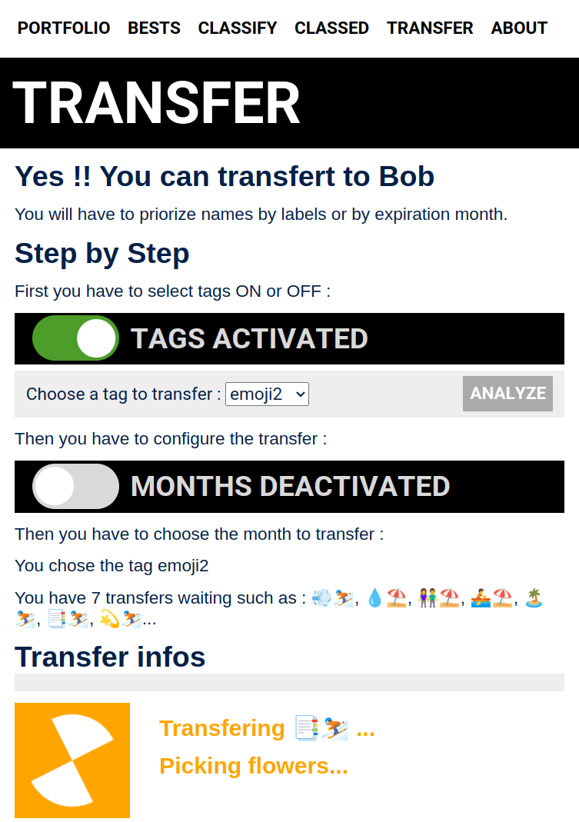
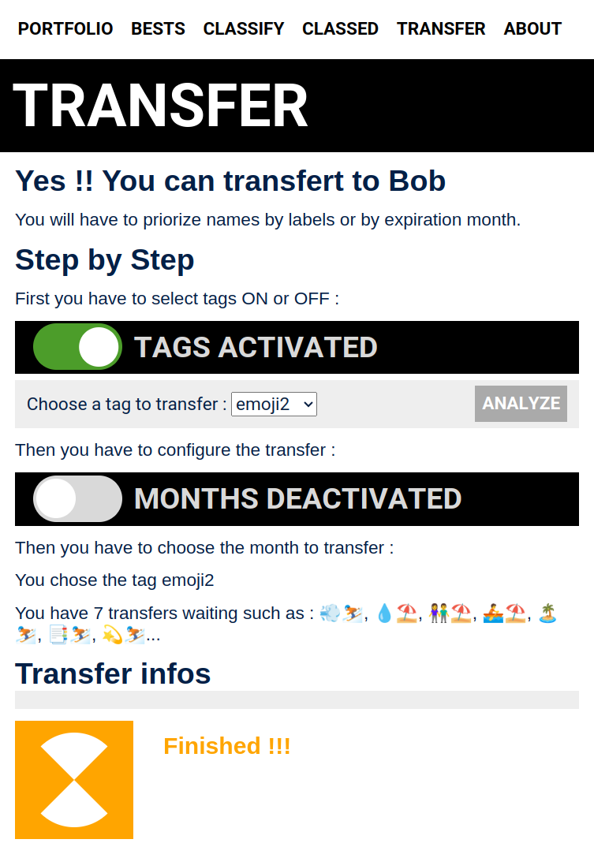
After clicking Transfer now

Slide 19
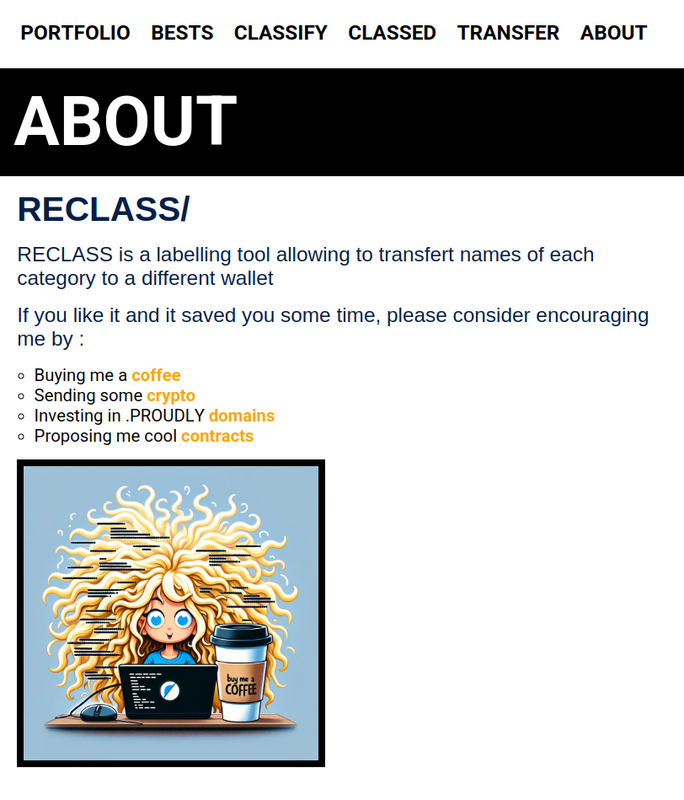

If it did go well, and you saved a lot of time, you can take 2 minutes to go to the about page. Please consider buying me 👩🏼‍💻 a coffee ☕ in the About page. 🙂
RECLASS/
Buying me a coffee
Sending some crypto
Investing in .PROUDLY domains
Proposing me cool contracts
Finally you send me a coffee !! I like coffee

Slide 20
RECLASS/
A
BEGINNER
TUTORIAL
a userscript for tagging and batch-transfers

